Slide 1
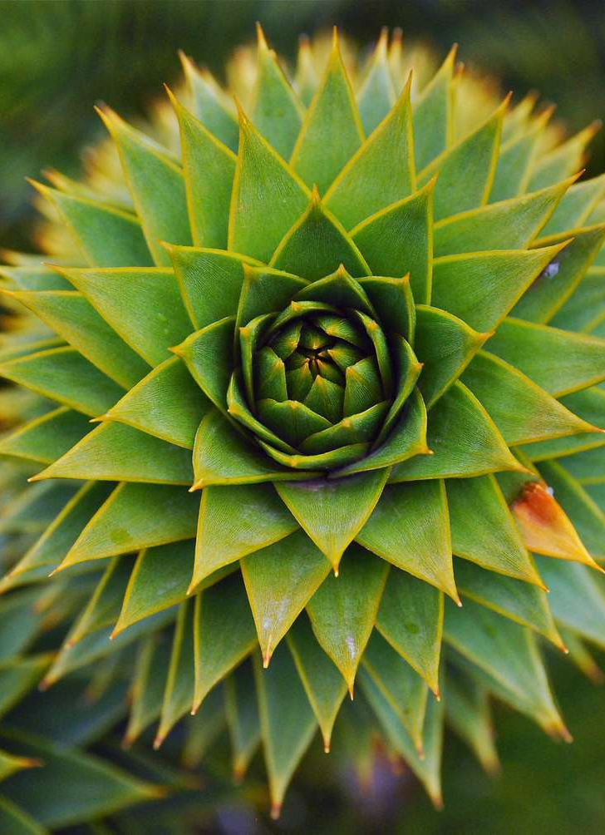
FRACTALS AND THEIR DIMENSION
Vedanshee Patel
202203003
Mentors:
Prof. Mukesh Tiwari
Prof. Prosenjit Kundu

Slide 2
CONTENTS
Book: Chaos And Fractals: New Frontiers of Science by Heinz-Otto Peitgen Hartmut Jürgens Dietmar Saupe : Ch-1- 4
Book: Non-linear Dynamics And Chaos by Steven H. Strogatz: Ch- 11
Book: Introduction to the Theory of Complex Systems by Stefan Thurner, Rudolf Hanel, and Peter Klimek : Ch-3
Research Paper: MEASURING THE STRANGENESS OF STRANGE ATTRACTORS by Peter GRASSBERGER and Itamar PROCACCIA
WHAT WILL WE DISCUSS?
We will see how to find dimension for the different fractals.

Slide 3
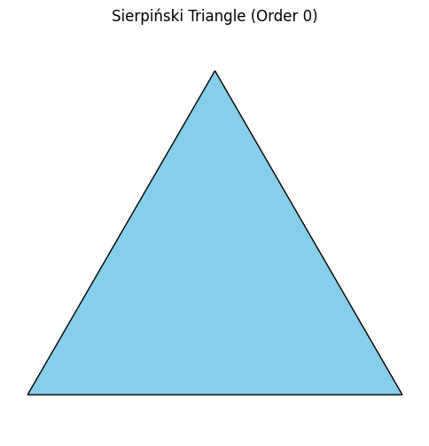
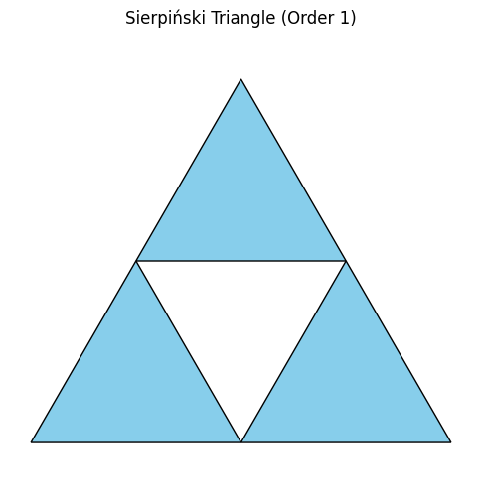
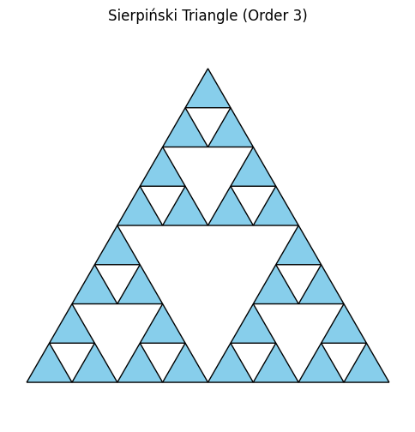
WHAT ARE FRACTALS ?
Fractals are self-similar patterns that repeat at different scales.
They show geometric repetition, where shapes appear nested within each other.
A fractal can be split into parts, each resembling the whole.
Fractals were first coined and discovered by Benoit Mandelbrot in 1975, where he found patterns in white noise data while working at IBM.

Slide 4
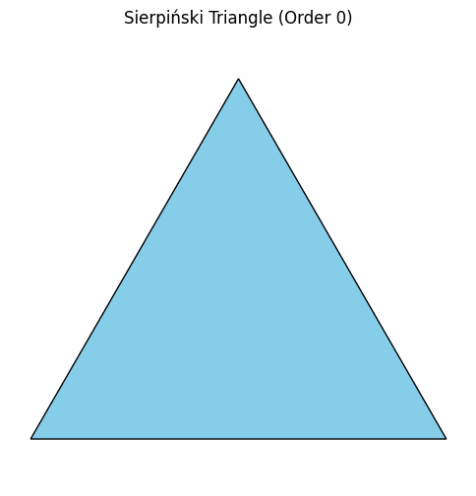
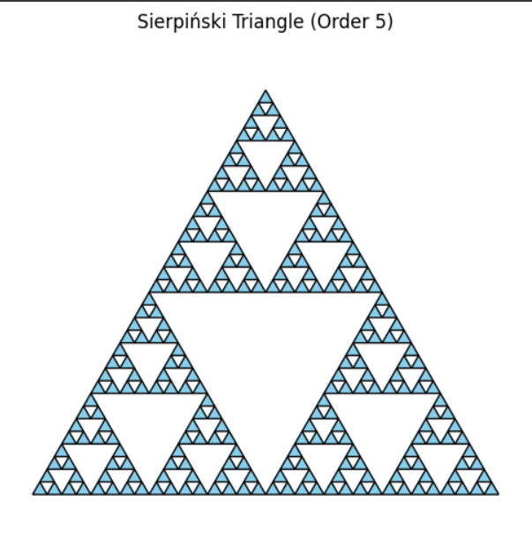
EXAMPLE OF FRACTALS

Slide 5
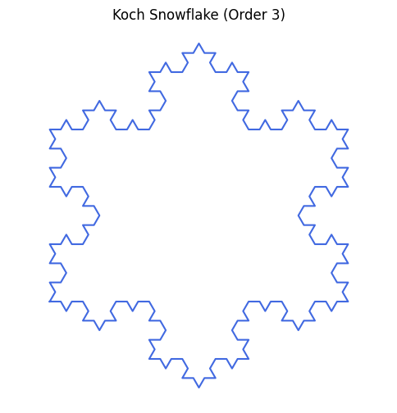
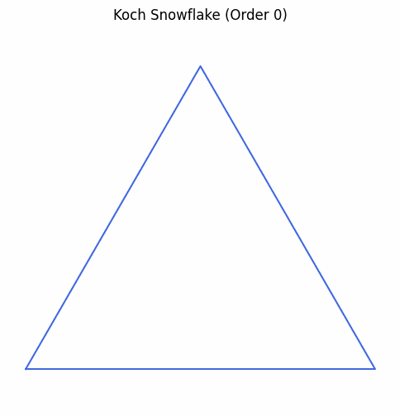
EXAMPLE OF FRACTALS

Slide 6
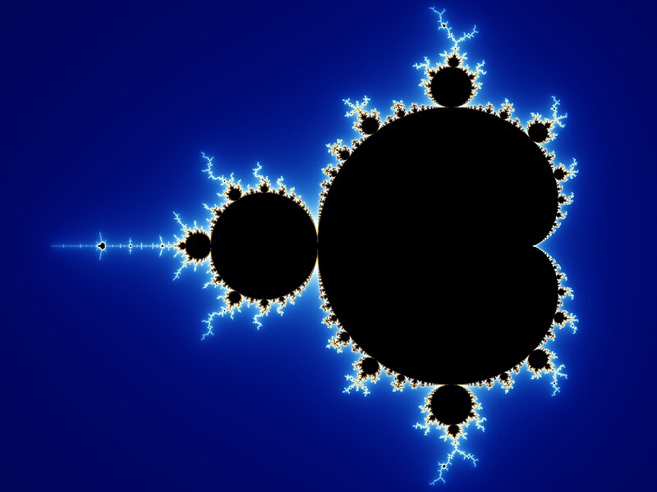
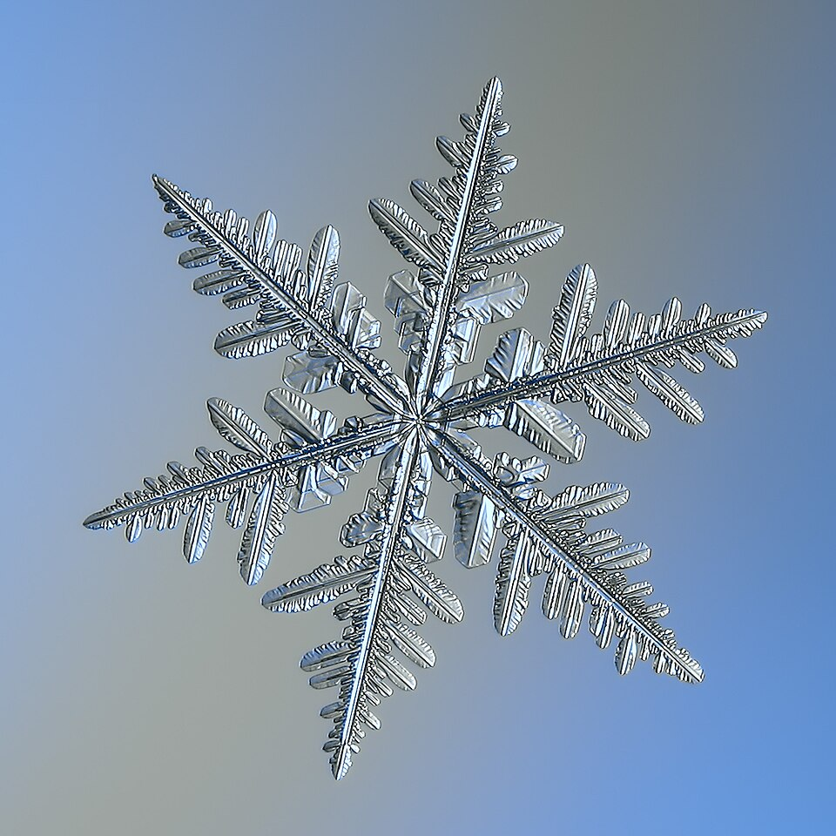
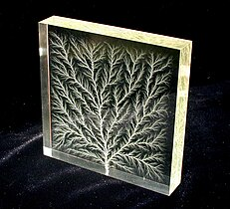
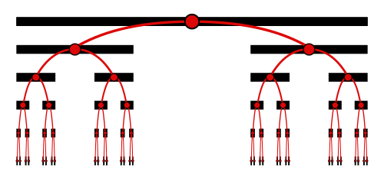
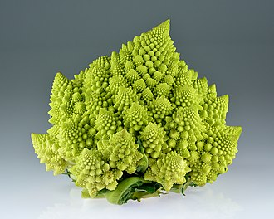
OTHER EXAMPLE OF FRACTALS
High-voltage breakdown within a 4 in (100 mm) block of acrylic glass
Mandelbrot Set
Snowflake
Romanesso
Broccoli
Cantor Set
Source : Wikipedia and Wikidata

Slide 7
WHY ARE THEIR DIMENSIONS FRACTIONAL?
Fractals are said to have filled their space qualitatively and quantitatively differently from how an ordinary geometrical set does.
Their complexity comes from self-similarity at every scale.
Infinite detail makes them defy traditional geometric dimensions.
This is not like density; it measures the complexity of the curve/set.

Slide 8
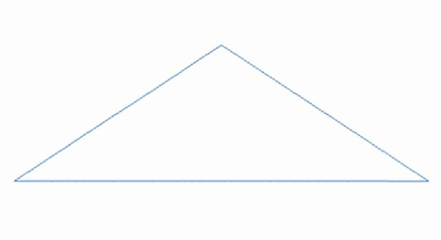
WHY DO WE NEED TO FIND THEIR DIMENSION?
Finding their dimension helps us understand their complexity and how they scale
These help us describing and study patterns and shapes that are difficult to characterise with traditional geometry.
This is useful in various fields like mathematics, natural sciences, and even art.
Source - Wikipedia: Fractals

Slide 9
METHODS TO FIND DIMENSION
Hausdorff-Besicovitch Dimension
Pointwise-Dimension
Correlation Dimension
Box-counting
Packing Dimension
Assouad Dimension
Lyapunov dimension
Information Dimension
Rényi or Generalised dimensions
What we will focus on majorly in this slides:
Scaling
Box-counting Dimension
Pointwise-Dimension
Correlation Dimension

Slide 10
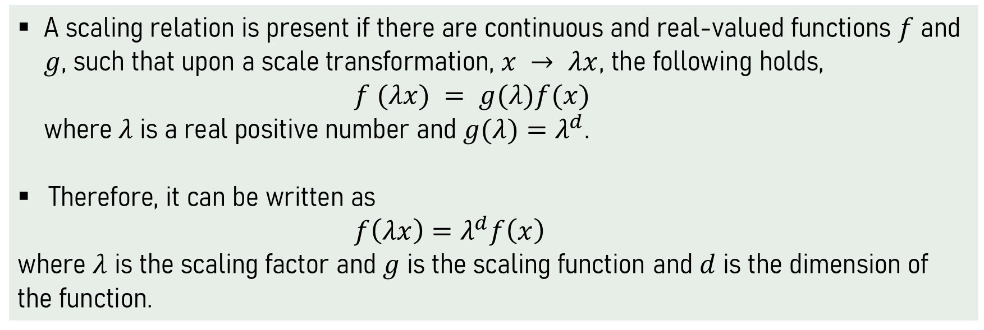
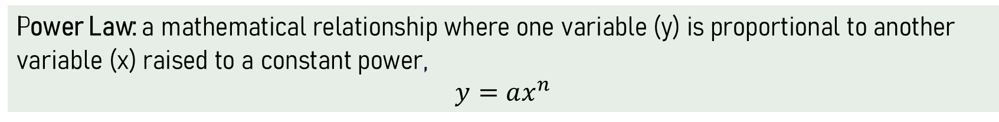
SCALING
A scaling relation is present if there are continuous and real-valued functions $f$ and $g$, such that upon a scale transformation, $x → λx$, the following holds,
$f (λx) = g(λ)f(x)$
where$λ$is a real positive number and $g(λ)=λ^{d}$.
Therefore, it can be written as
$f\left(λx\right)=λ^{d}f\left(x\right)$
where $λ$ is the scaling factor and $g$ is the scaling function and $d$ is the dimension of the function.
Power Law: a mathematical relationship where one variable (y) is proportional to another variable (x) raised to a constant power,
$$y=ax^{n}$$

Slide 11
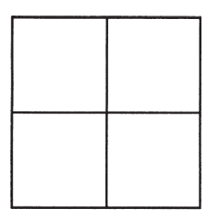
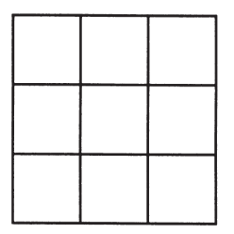
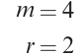
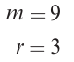
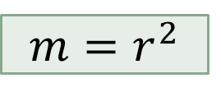
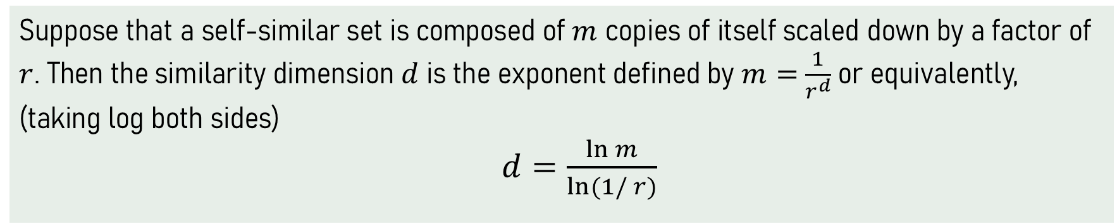
SCALING
For geometric shapes
m = number of copies
r = scale factor
$$m=r^{2}$$
Suppose that a self-similar set is composed of $m$ copies of itself scaled down by a factor of $r$. Then the similarity dimension$d$is the exponent defined by $m=$ $\frac{1}{r^{d}}$ or equivalently, (taking log both sides)
$d=\frac{\ln{m}}{ln(1/{r)}}$

Slide 12
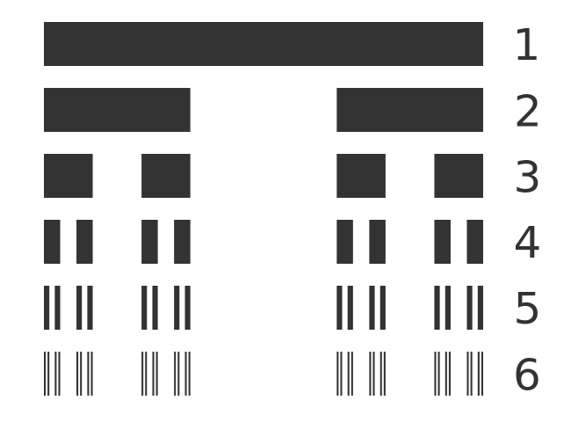
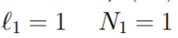
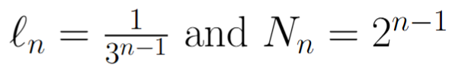
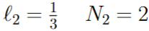
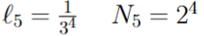
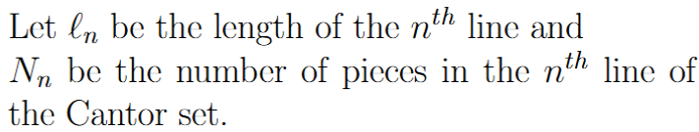
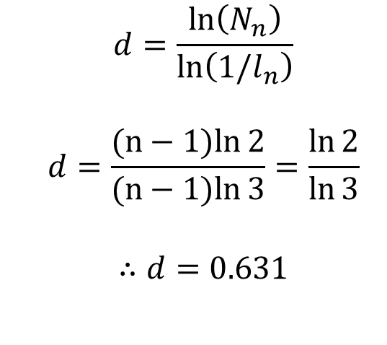
DIMENSION FOR CANTOR SET
$$d=\frac{\ln\left(N_{n}\right)}{\ln\left(1/l_{n}\right)}$$
$$d=\frac{(n−1)ln{2}}{(n−1)ln{3}}=\frac{\ln{2}}{\ln{3}}$$
$$∴d=0.631$$
Source – Graphic Math -Cantor Set

Slide 13
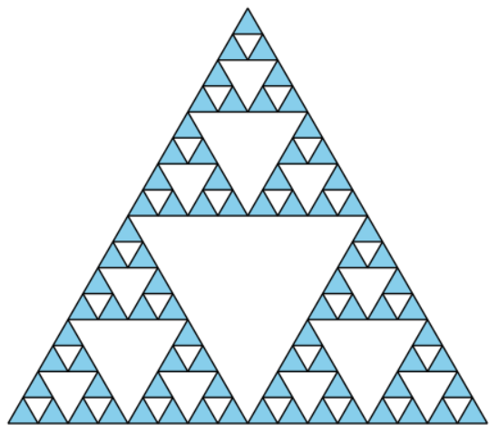
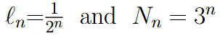
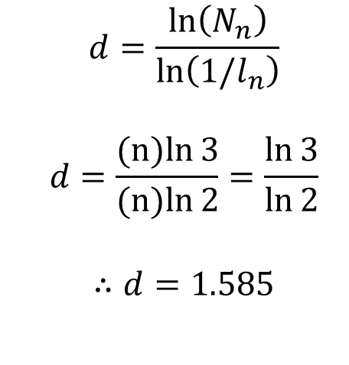
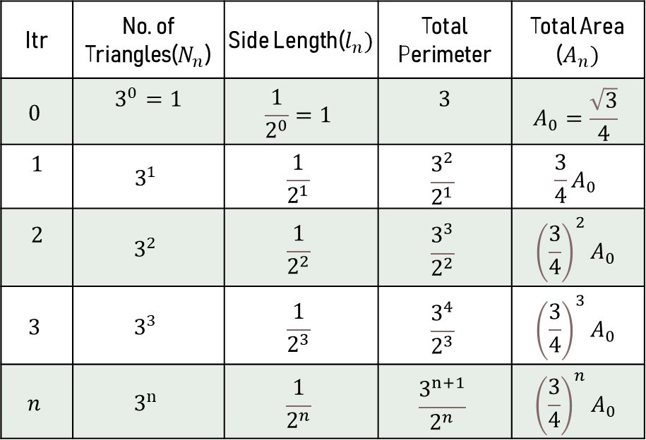
DIMENSION FOR SIERPINSKI TRIANGLE
Itr | No. of Triangles($N_{n}$) | Side Length($l_{n})$ | Total Perimeter | Total Area ($A_{n})$
$$0$$ | $$3^{0}=1$$ | $$\frac{1}{2^{0}}=1$$ | $$3$$ | $$A_{0}=\frac{\sqrt{3}}{4}$$
$$1$$ | $$3^{1}$$ | $$\frac{1}{2^{1}}$$ | $$\frac{3^{2}}{2^{1}}$$ | $$\frac{3}{4}A_{0}$$
$$2$$ | $$3^{2}$$ | $$\frac{1}{2^{2}}$$ | $$\frac{3^{3}}{2^{2}}$$ | $${\left(\frac{3}{4}\right)}^{2}A_{0}$$
$$3$$ | $$3^{3}$$ | $$\frac{1}{2^{3}}$$ | $$\frac{3^{4}}{2^{3}}$$ | $${\left(\frac{3}{4}\right)}^{3}A_{0}$$
$$n$$ | $$3^{n}$$ | $$\frac{1}{2^{n}}$$ | $$\frac{3^{n+1}}{2^{n}}$$ | $${\left(\frac{3}{4}\right)}^{n}A_{0}$$
$$d=\frac{\ln\left(N_{n}\right)}{\ln\left(1/l_{n}\right)}$$
$$d=\frac{(n)ln{3}}{(n)ln{2}}=\frac{\ln{3}}{\ln{2}}$$
$$∴d=1.585$$

Slide 14
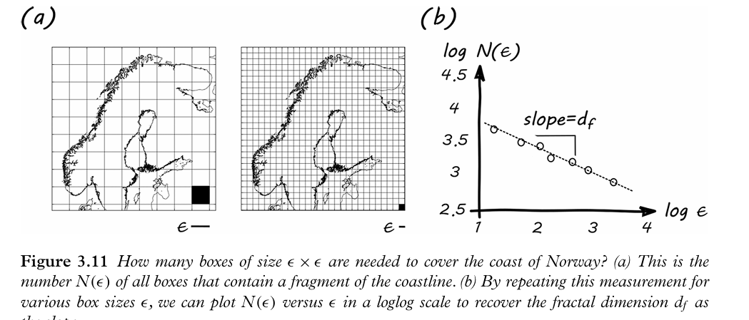
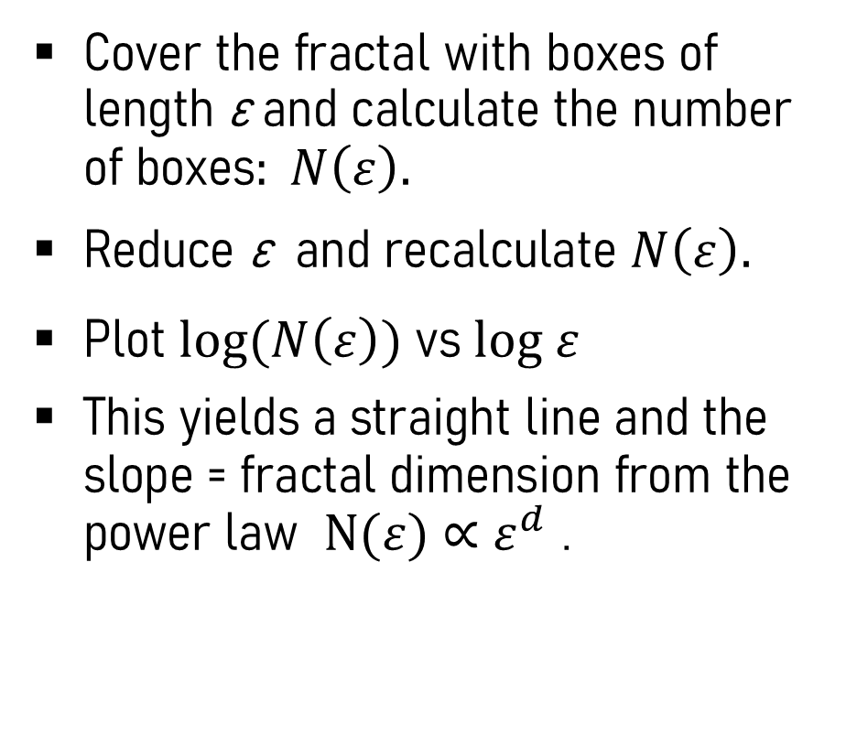
WHAT IS BOX-COUNTING DIMENSION?
Cover the fractal with boxes of length ε and calculate the number of boxes$: N\left(ε\right).$
Reduce ε and recalculate $N\left(ε\right).$
Plot $log(N\left(ε\right))$vs $log ε$
This yields a straight line and the slope = fractal dimension from the power law $N(ε)$ $∝$ $ε^{d}$ .
Coast of Norway
Source : Introduction-To-The-Theory-Of-Complex-Systems : page -129

Slide 15
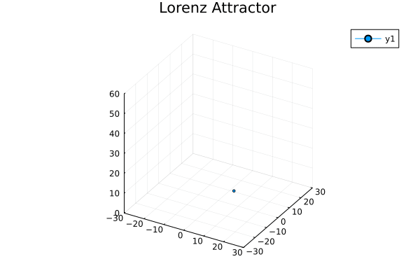
DIMENSION FOR ATTRACTORS
Fractal dimension for geometric fractals using the simple idea of scaling and box-counting.
Dynamical Systems is a system that describes how a point in space moves with respect to time.
Attractors are the minimal set of points to which neighbouring trajectories in a phase portrait converge.
A Strange Attractor can be put as an attractor that exhibits dependence on the initial condition.
Source: Fractals : Wikipedia

Slide 16
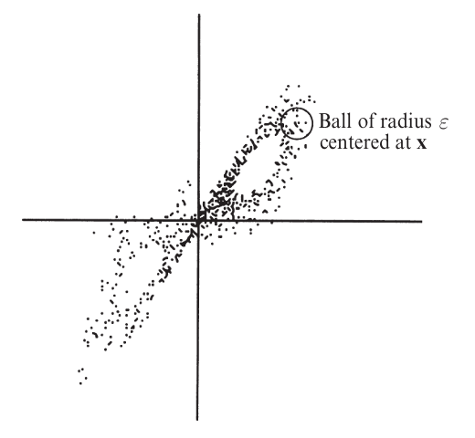
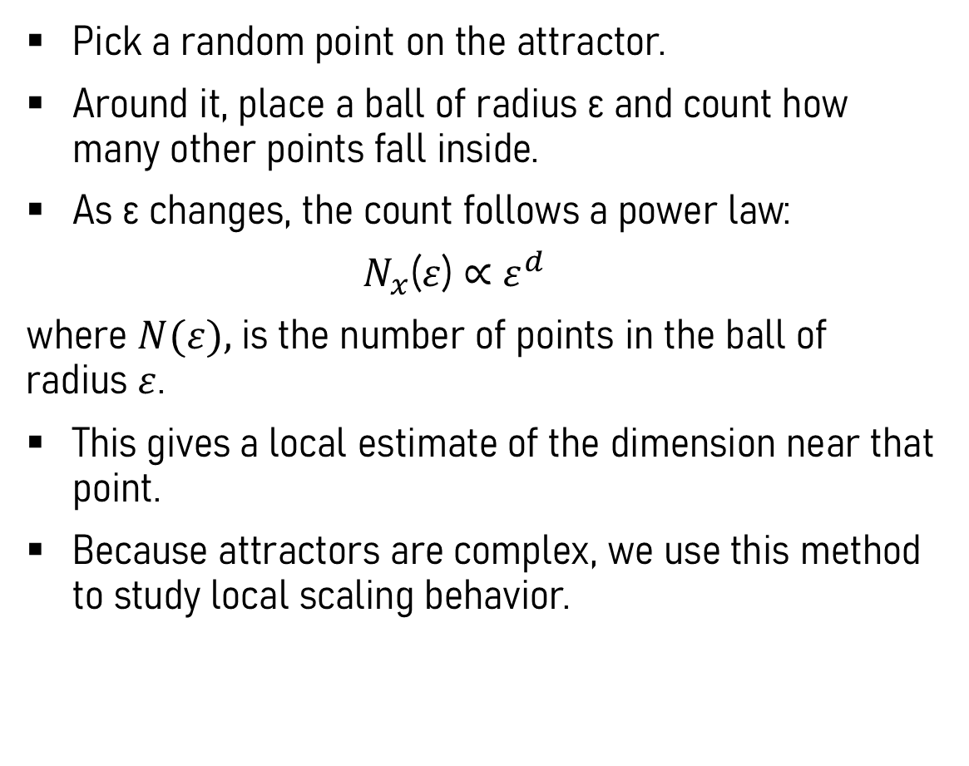
WHAT IS POINTWISE DIMENSION?
Pick a random point on the attractor.
Around it, place a ball of radius ε and count how many other points fall inside.
As ε changes, the count follows a power law:
$N_{x}$($ε$) $∝$ $ε^{d}$
where $N(ε),$is the number of points in the ball of radius $ε$.
This gives a local estimate of the dimension near that point.
Because attractors are complex, we use this method to study local scaling behavior.
Scattered plot of the Lorenz Attractor in the X-Y plane
Source: Non-Linear Dynamics And Chaos :page 418

Slide 17
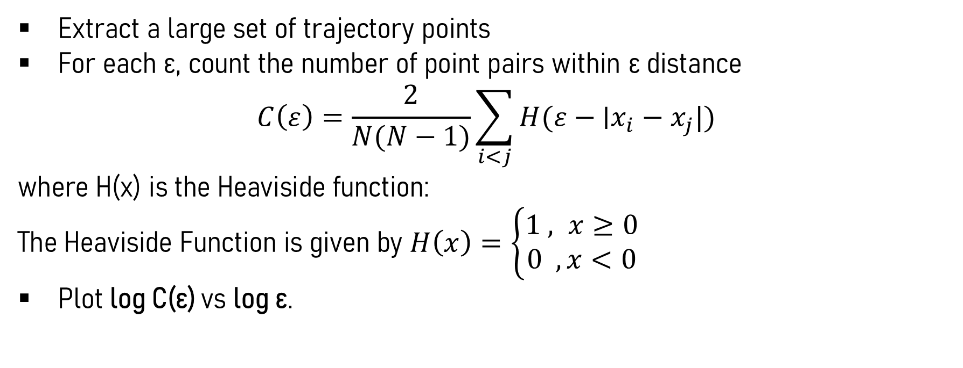
WHAT IS CORRELATION DIMENSION?
Grassberger–Procaccia Algorithm
Extract a large set of trajectory points
For each ε, count the number of point pairs within ε distance
$$C\left(ε\right)=\frac{2}{N(N−1)}\sum_{ⅈ<j}{H(ε−\text{∣}x_{i}\text{​}−x_{j}\text{​}|)}$$
where H(x) is the Heaviside function:
The Heaviside Function is given by $H\left(x\right)=\left\{\begin{aligned}1 , x≥0 \\ 0 , x<0\end{aligned}\right.$
Plot log C(ε) vs log ε.
17

Slide 18
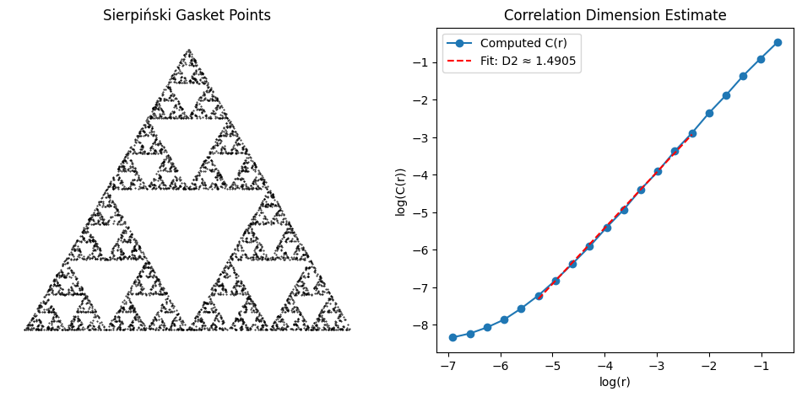
SERPIENSKI TRIANGLE

Slide 19
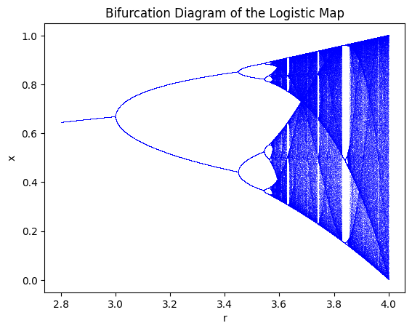
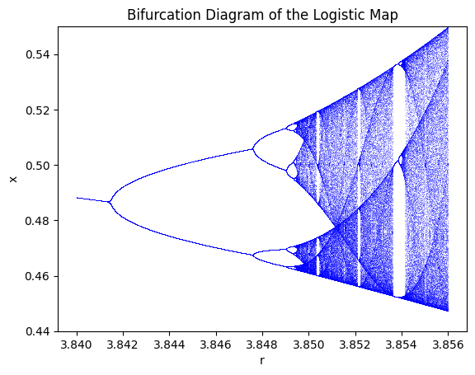
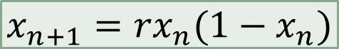
LOGISTIC MAP
$$x_{n+1}={rx}_{n}(1−x_{n})$$

Slide 20
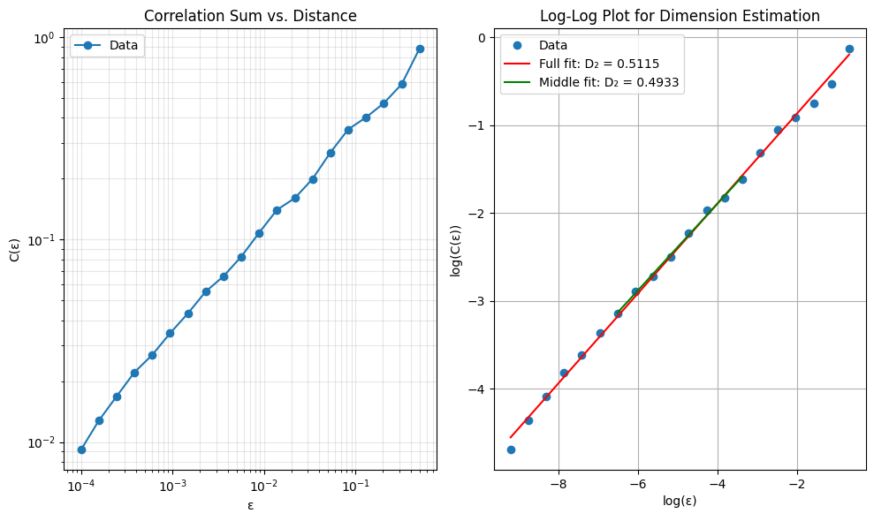

LOGISTIC MAP
$$x_{n+1}={rx}_{n}(1−x_{n})$$

Slide 21
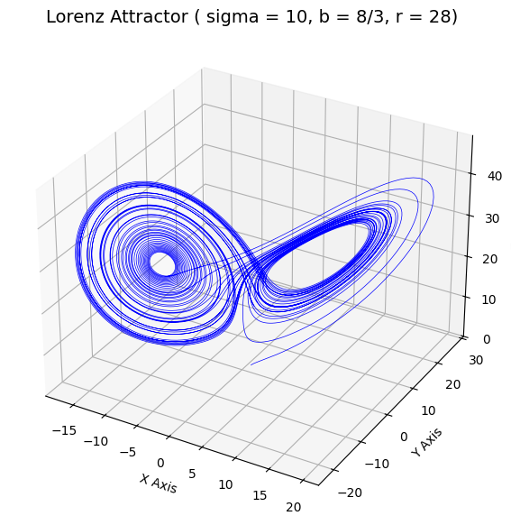
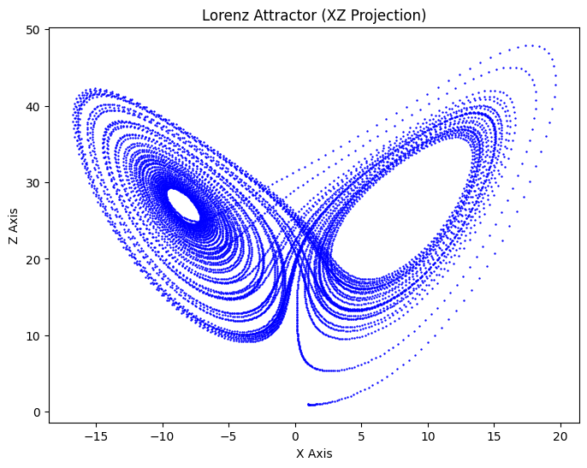
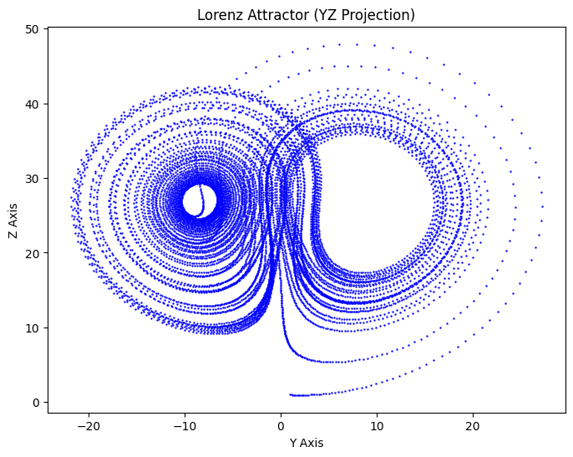
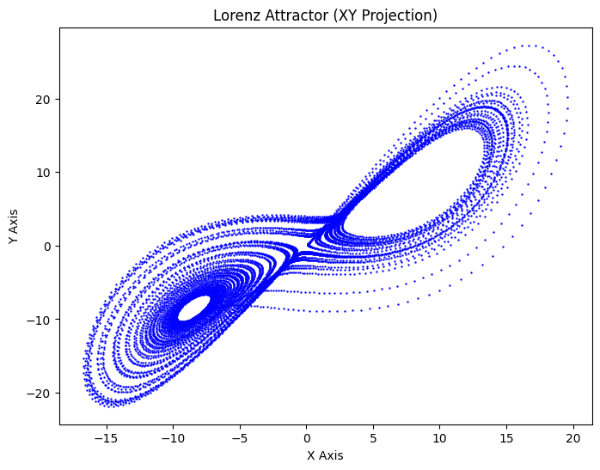
LORENZ ATTRACTOR

Slide 22
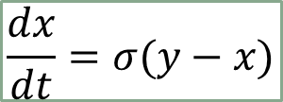
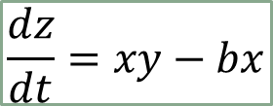

LORENZ ATTRACTOR
$$\frac{dx}{dt}=σ(y−x)$$
$$\frac{dy}{dt}=x\left(r−z\right)−y$$
$$\frac{dz}{dt}=xy−bx$$

Slide 23






LORENZ ATTRACTOR
$$\frac{dx}{dt}=σ(y−x)$$
$$\frac{dy}{dt}=x\left(r−z\right)−y$$
$$\frac{dz}{dt}=xy−bx$$

Slide 24

THANK YOU!
Source : Wikipedia : Fractals

